Slide 1
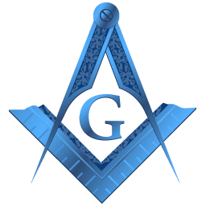
The Belief in a Supreme Being?
Harvey Lovewell
ANZMRC Conference 2022 In Dunedin.
Theme:- “Beyond the Craft”
WHJ Mayers Centre of Masonic Education and Knowledge.

Slide 2
Some quotes upon which to ponder!
Discussion is an exchange of knowledge
Argument is an exchange of ignorance Robert Quillen journalist (1887-1948).
What we think, or what we know,
or what we believe is,
of little consequence.
The only consequence is what we do. John Ruskin Philosopher, Philanthropist and Social Reformer. (1914-1900)

Slide 3
“If you would be a real seeker after truth, it is necessary that at least once in your life you doubt, as far as possible, all things” – Rene Descartes
“Truth is a shining goddess, always veiled, always distant, never wholly approachable, But worthy of all the devotion of which the human spirit is capable” Bertrand Russell
And from Bertrand Russell.

Slide 4
300 years ago Freemasons were among the most intelligent and progressive people, the pioneers of the Enlightenment — the Age of Reason. Today’s Freemasons are different, for the most part, and the intellectual ones are a small minority, especially in North America.
Peter Renzland, Toronto Society for Masonic Research. Governance, Constitution, Founding Texts.

Slide 5
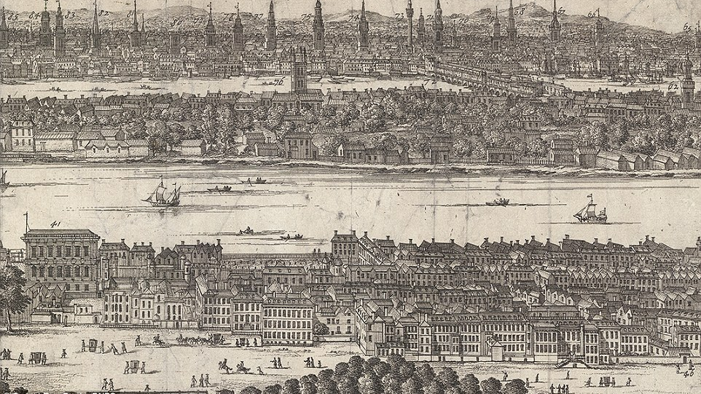
London Three Hundred years ago

Slide 6
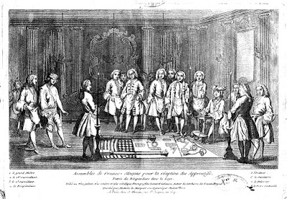

Slide 7
Humans like to attribute causes to events and attempt to understand what is taking place around them. This is why individuals have been using religious ceremonies for centuries to invoke the will of the gods – because they believed the gods controlled certain elements of the natural world (e.g., the weather).
Origin of Sociology as a Discipline Sambit Mallick 2015

Slide 8
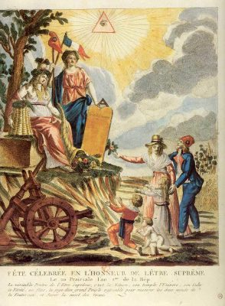
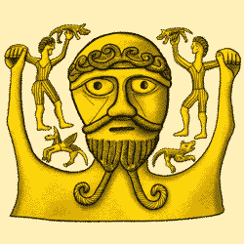
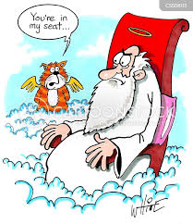
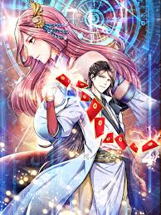
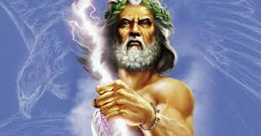
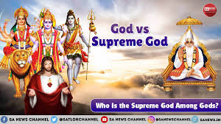
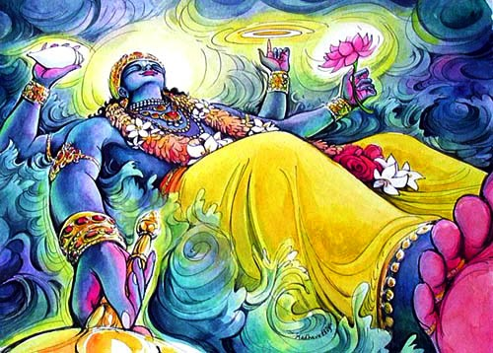
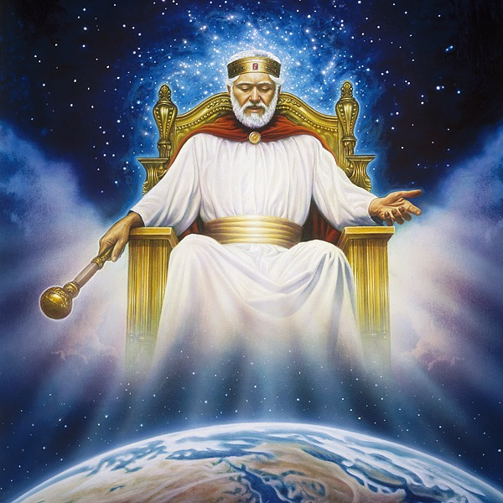
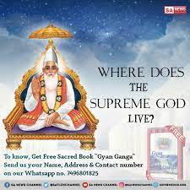
Ideas
Of
a
Supreme
Being

Slide 9
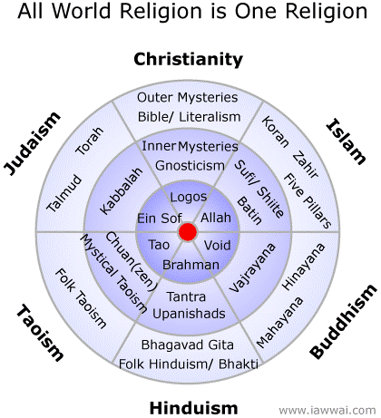
IS ALL MANKIND GOD?
Wai H Tsang.
In his book “Quest”
Hypothesises that
All mankind is God.

Slide 10
Paul Carus in his work “The History of the Devil” on page 4 has this definition;
We define God as "that authoritative presence in the All, which enforces a definite moral conduct."
God is that something which constitutes the harmony of the laws of nature; God is the intrinsic necessity of mathematics and logic; God above all is what experience teaches us to be the inalienable features of righteousness, justice, morality.

Slide 11
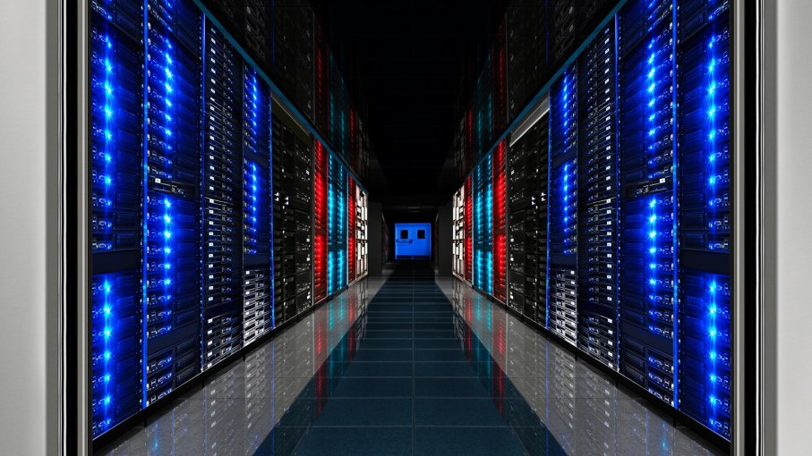
  what is going to be created will effectively be a god. It's not a god in the sense that it makes lightning or causes hurricanes. But if there is something a billion times smarter than the smartest human, what else are you going to call it? And this time you will be able to talk to God, literally, and know that it’s listening.
A new church?

Slide 12
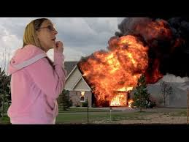
I don’t believe it! You better believe it!

Slide 13
From Wiki, Belief is the state of mind in which a person thinks something to be the case with or without there being empirical evidence to prove that something is the case with factual certainty
Contemporary analytic philosophers of mind generally use the term “belief” to refer to the attitude we have, roughly, whenever we take something to be the case or regard it as true. To believe something, in this sense, needn't involve actively reflecting on it:
Stanford Encyclopedia of Philosophy

Slide 14
So what of belief?
The word belief comes from two words.
Be and lief
Be: comes from being, which is a state of existence. To be is to live.
The second word lief comes from the Indo-European word leubh which means – love.
So when you put them together it changes the entire idea of the word belief.
Belief then means to be in love with.
Would you believe that?

Slide 15
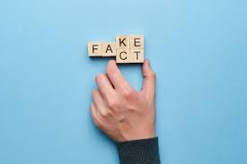
So why then should we as Regular Freemasons demand a belief in a Supreme Being?
As can be seen from the previous slide, belief is a relative state of consciousness that is abstract.
So, what then is a fact?
A Fact is the representation of reality as it is.
If this is so, what then is the truth? Truth is what is believed to be a fact by a person. That means you can believe whatever you want to believe. As long as you believe it to be true, it will be true for you and your life

Slide 16
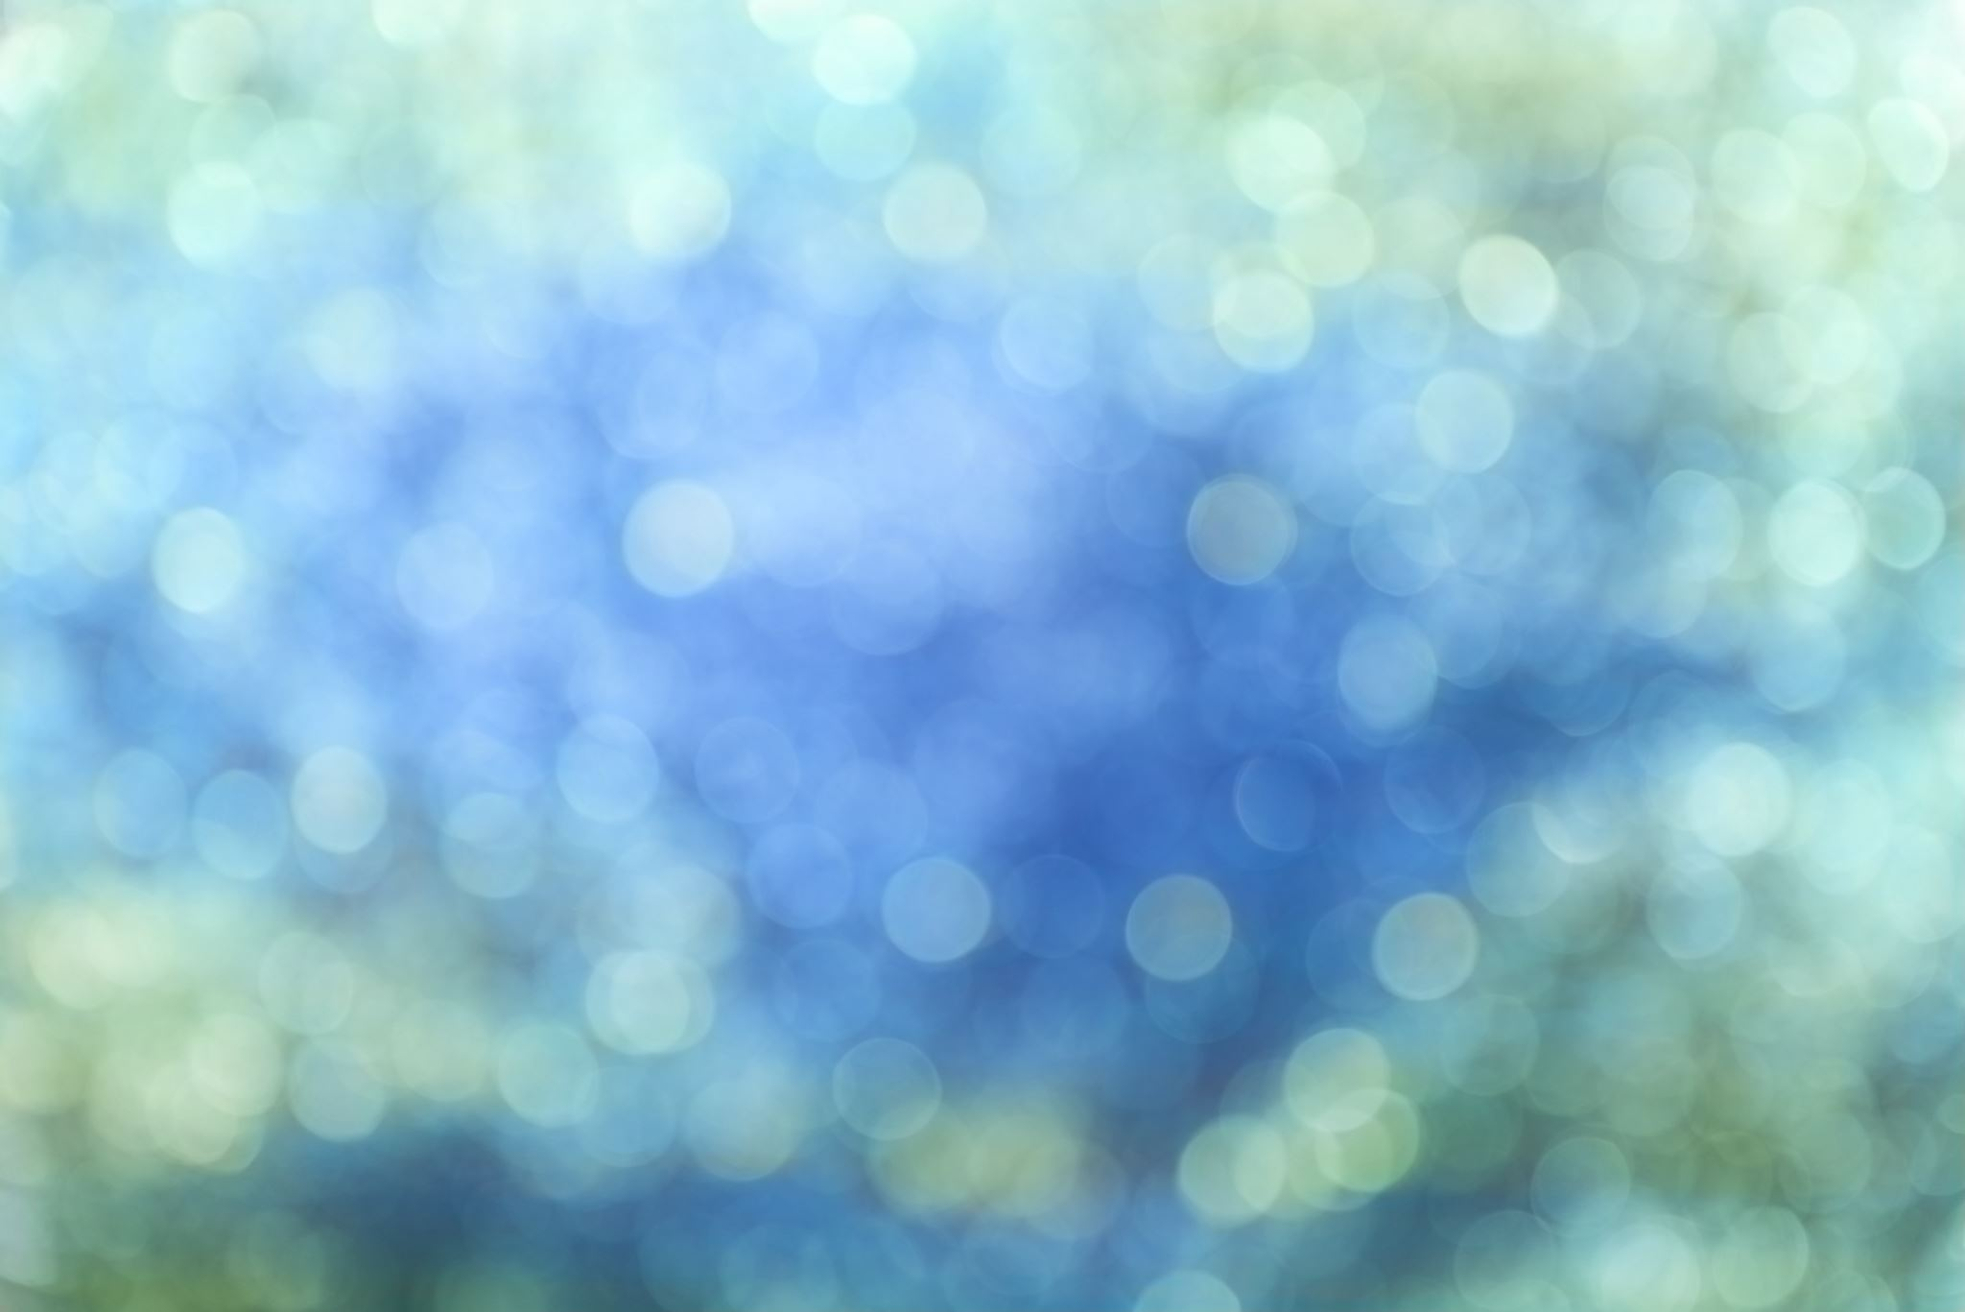
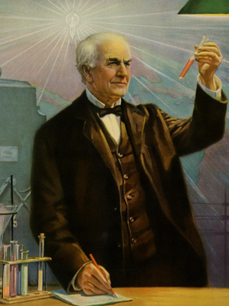
Quotes
To those searching for truth- not the truth of dogma and darkness but the truth brought by reason, search, examination, and inquiry, discipline is required.
For faith, as well-intentioned as it may be, must be built on facts, not fiction -faith in fiction is a damnable false hope. -
Thomas A. Edison

Slide 17
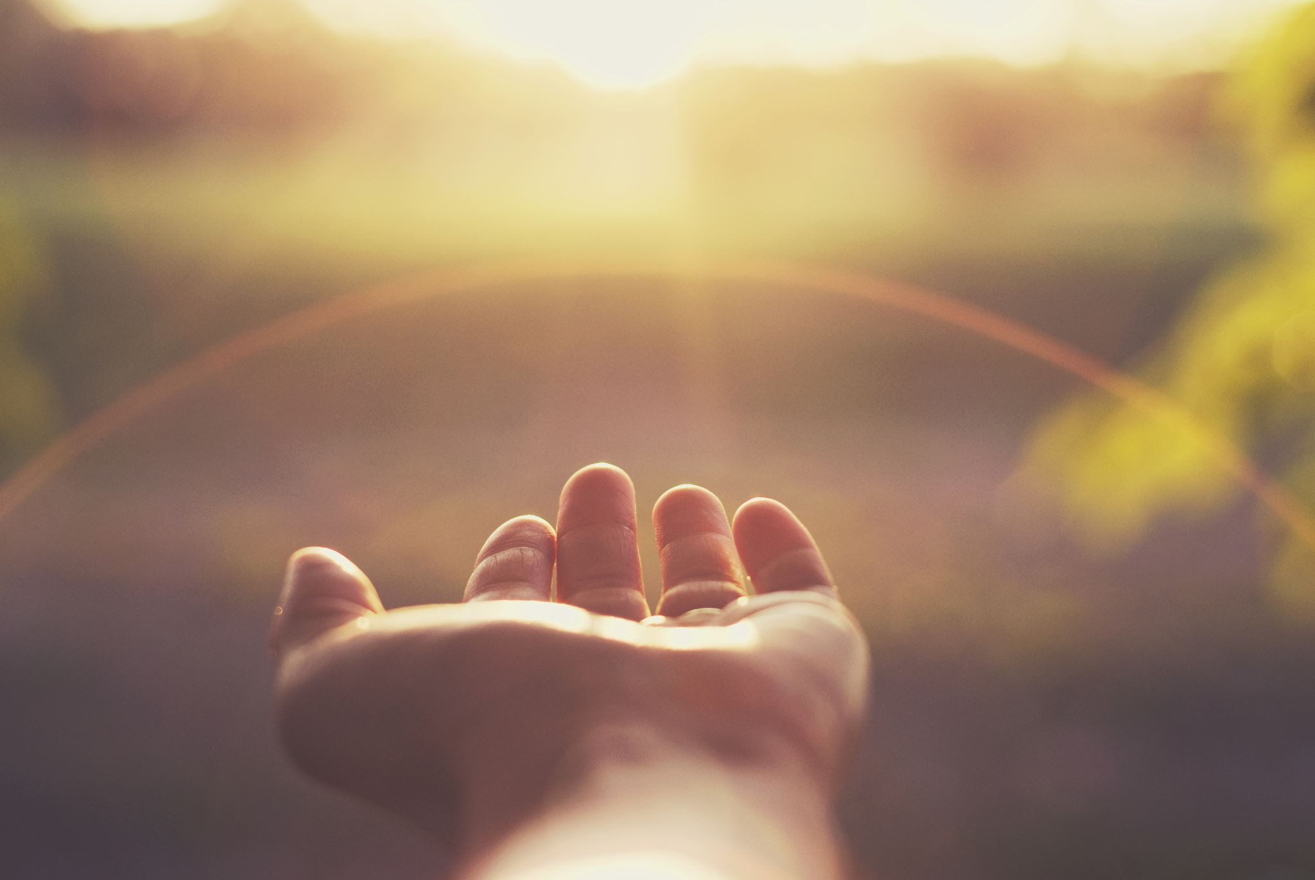
Belief and Knowledge.
To understand the difference between belief and knowledge we need to understand how each is defined.
Beliefs are those things that we understand to be true but may not be True. ...
In other words, belief is the necessary result of being convinced.

Slide 18
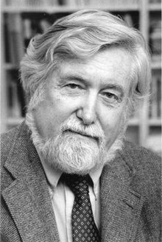
The system of symbols which acts to establish powerful, pervasive, and long-lasting moods and motivations in men by formulating conceptions of a general order of existence and clothing these conceptions with such an aura of factuality that the moods and motivations seem uniquely realisticpo
Clifford Geertz. 1926-2006 expert in Cultural Symbols.erful pervasive, and long-lasting moods and motivations in men by formulating conceptions of a general order of existence and clothing these conceptions with such an aura of factuality that the moods and motivations seem uniquely realistic.
System, 1973
Religion Defined

Slide 19
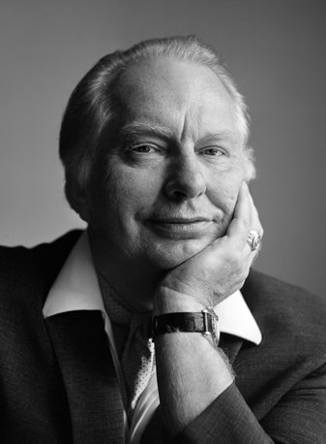
L Ron Hubbard. Quotes
Started the Scientology Religion.
Is quoted as saying You don't get rich writing science fiction. If you want to get rich, you start a religion He did this in 1952
The only way you can control anybody is to lie to them

Slide 20
Religion usually describes the belief in a superhuman controlling power involving a God or gods; it entails a system of faith and worship as well as, like Ideology an underlying set of values, myths, ideas, attitudes, beliefs and doctrine that shape the behavioural approach to political, economic, social, cultural values.
Ideology then refers to a set of beliefs and doctrines that back a certain social institution or an organization. Personal ideology is an individual's philosophy of how life should be and of what forces influence human living.

Slide 21
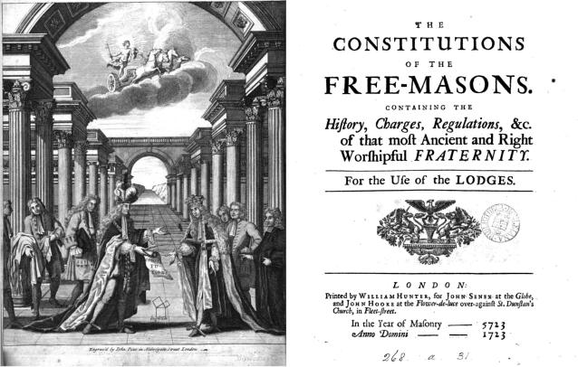

Slide 22
A Mason is oblig’d by his Tenure, to obey the moral Law; and if he rightly understands the Art, he will never be a stupid Atheist, nor an irreligious Libertine. But though in ancient Times Masons were charg’d in every Country to be of the Religion of that Country or Nation, whatever it was, yet ’tis now thought more expedient only to oblige them to that Religion in which all Men agree, leaving their particular Opinions to themselves; (my emphasis) that is, to be good Men and true, or Men of Honour and Honesty, by whatever Denominations or Persuasions they may be distinguish’d ; whereby Masonry becomes the Center of Union, and the Means of conciliating true Friendship among Persons that must else have remain’d at a perpetual Distance.
From 1723, the original Grand Lodge Constitutions.

Slide 23
A Mason is obliged, by his tenure, to obey the moral law; and if he rightly understand the art he will never be a stupid atheist nor an irreligious libertine. He, of all men, should best understand that GOD seeth not as man seeth; for man looketh at the outward appearance, but GOD looketh to the heart. A mason is, therefore, particularly bound never to act against the dictates of his conscience. Let a man's religion or mode of worship be what it may, he is not excluded from the order, provided he believe in the glorious architect of heaven and earth, and practise the sacred duties of morality. Masons unite with the virtuous of every persuasion in the firm and pleasing bond of fraternal love; they are taught to view the errors of mankind with compassion, and to strive, by the purity of their own conduct, to demonstrate the superior excellence of the faith they may profess. Thus masonry is the centre of union between good men and true, and the happy means of conciliating friendship amongst those who must otherwise have remained at a perpetual distance.
The 1815 Constitution

Slide 24
Grand Orient of France
Founded in 1728 or 1733 or 1736. Records vary.
In 1877, at the instigation of the Protestant pastor Frédéric Desmons, it allowed those who had no belief in a supreme being to be admitted.
The Grand Orient advanced the concept of Laïcité, a French concept of the separation of church and state and the absence of religious interference in government affairs.
It upholds a series of guiding principles or ideals (valeurs), which individual members are expected to defend, and which the Grand Orient as a corporate body promotes; like Democracy. Laicity, Social Solidarity, Citizenship, Environment, Human Dignity and Human Rights.

Slide 25
As one Scottish Grand Lodge authority puts it
The Volume of the Sacred Law, no matter though it be our Bible or the Sacred Writings of the Hindu, the Zendavesta of the Parsee, or the Koran of the Mohammedan, typifies the Mind or Will of the GAOTU, the Great First Cause - the Creator and Preserver of the Universe - the Great Life-Giver, that Great Unknown and Unknowable which is manifested in His Universe. It is a symbol and a symbol only, and it is shown as supporting the other two symbols, the Square and Compasses (my emphasis)

Slide 26
What is an Oath/Vow?
Every Candidate is required to take his Obligation on that book or on the Volume which is held by his creed to impart sanctity to an oath or promise taken upon it. So how do we define an oath?
A call upon a revered person or thing, to witness one's determination to speak the truth, to keep a promise, etc.: to testify upon oath.
A statement or a promise strengthened by such an appeal. A formally affirmed solemn appeal to a deity, or to some statement or promise accepted as an equivalent of an appeal to a deity or to a revered person or thing; affirmation.
Dictionary.com

Slide 27
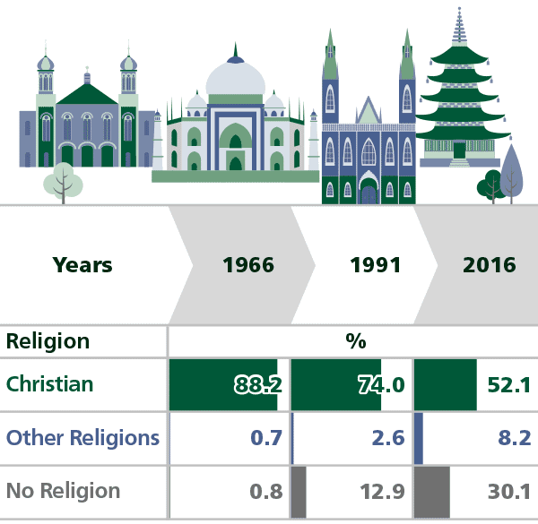
Australian Census results.
2021
Figures
Not
available

Slide 28
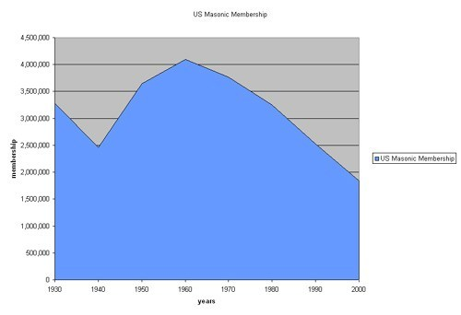
Masonic Membership in the United States of America. Graph for Australia is similar

Slide 29
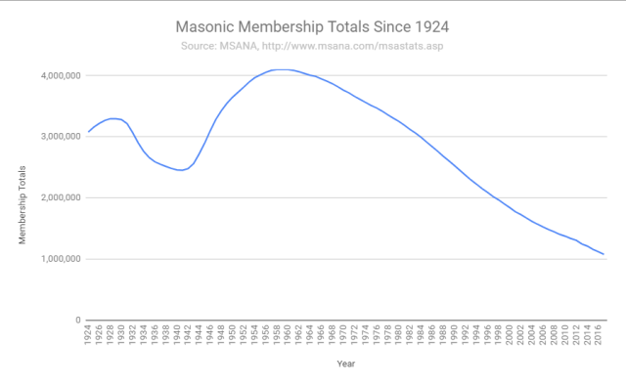
Decline in Masonic Membership.
Freemasonry decline in USA
Similar graph for Australia but numbers differ

Slide 30
Words from the Grand Orient of France
The Grand Orient of France, while it respects all philosophical beliefs, insists upon absolute liberty of belief. This does not mean that we banish from our lodges the belief in God.
I can affirm that the Grand Orient of France is neither deist, atheist, nor positivist. All philosophical conceptions are represented within its body.
A resolution passed in the early 19th century by GODF "neither colour, race, nor religion should disqualify a man for initiation.
I again quote the UGLE constitution. that is, to be good men and true, or Men of Honour and Honesty.

Slide 31
The Questions we need to ponder.
Will an insistence on the belief in a Supreme Being accelerate Freemasonry’s demise?
Freemasonry is in decline which is a fact not a belief.
Is a belief in a Supreme being the only way a man can be called “to be good Men and true, or Men of Honour and Honesty”, Grand Orient Lodges, who do not demand a belief in a supreme being, whose numbers are not declining, say not so.

Slide 32
In conclusion
My brothers, I ask that you consider the questions I have raised here. I think that we have to consider where we are going.
“Beyond the Craft”
and if there is a reason to change our direction then at least it should be part of our discussions.
I have tried to show that there is a need to consider change, a change for reality.

